Slide 1

Enhancing Vision System Capability in Factory Operations
KITES Technical Intern: Anmol Jain
ITD SRE

Slide 2
Objectives
Strengthening Vision System capability via improvements in Pack Vision System
Developing a scalable model for Pack Vision System to facilitate replicability across brands & lines
Identify and Implement Machine Learning algorithms to achieve better accuracy in Vision system
System to have False Detections < 0.1% and Defect capturing accuracy > 98%
Vision System must be capable for defect detection in various brands & easy to scale
Deliverables

Slide 3
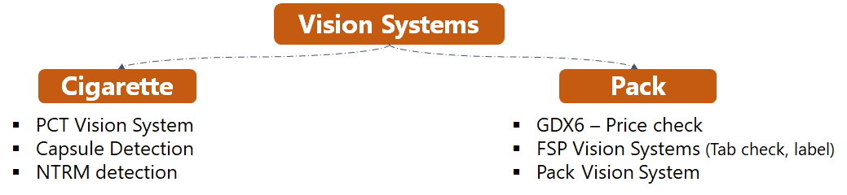
Business Context
Market Complaints Trends:
Increasing share of packet related defects
Possible Reasons:
Improvement on cigarette front
Increasing consumer sensitivity towards pack

Slide 4
Project Approach Brief
Understanding Vendor’s Model
Literature Survey
Unsupervised learning approach
Code Interfacing
Supervised learning approach
Retraining
Code optimization
Analyzing pack vision system infrastructure & model used; gain understanding on image analytics
Studying various ML models suitable to use case & intricacies involved via various research papers & online repositories
Develop an algorithm based on using non-defective images and checking accuracy parameters
Developing new interface code to generalize system for scalability & minimizing vendor dependability
Use a different algorithm for better training and achieve higher accuracy and less false detection rate
Retrain the model after having new insights in kind of defects that might escape and falsely detected packets as defective
Optimize the code for shop floor testing and Final Training codes are developed for easy future replication and scalability

Slide 5
Project Approach Brief
Understanding Vendor’s Model
Supervised learning approach
Code optimization
Defect Prioritization
Literature Survey
Unsupervised learning approach
Code Interfacing
Analyse vendor’s model
Learn image analytics techniques
Prioritize defects based on RPN
Study ML Models
Scan industry
Use non-defect images for training
Improve accuracy
Developing new interfacing code for online running
Minimize vendor dependability
Use both defected & good images for training
Improve to achieve high accuracy & less false detections
Optimize: shopfloor testing
Easy future replication

Slide 6
Pack Defects (Understanding problem)
Few pack defects that received as market complaints in the past
Current System Checks
Pack Damage
Laser Missing
Reverse Blank
I/F Damage
Foil Damage/Reverse/ Embossing Wander
Top Lid-Missing/Damaged
Joint Tape
Open/Burnt Wrap
I/F Missing
Sequentially corrective measure taken at all machines to counter some of these defects
Offline systemic checks introduced in the past to take notice of defects
Gaps
No online mechanism to comprehensively monitor occurrence of all such defects in real time
Need for an intelligent
Vision System encompassing all pack defects

Slide 7
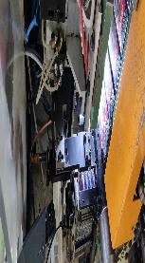
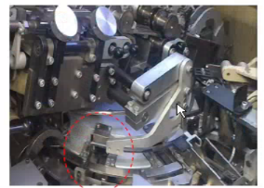

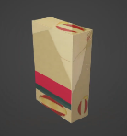
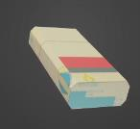
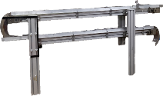

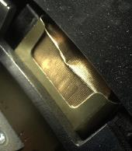

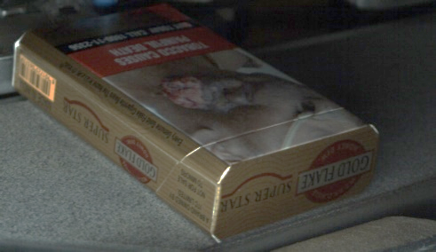
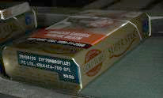
Pack Vision system - Comprehensive capturing of pack defects
4 camera setup for all packing related defect identification
Cam 1: Inner frame & bundle Cam 2: 3 panels
Cam 3: 3 panels & Price Check Cam 4: Wrapping
Camera 1
Checks Inner Frame and Foil
Set Up
Camera 4
Checks Wrapping Quality
Front Panel Up
Back Panel Up
Camera 2
Camera 2
Camera 3
Top
Packer
Side
Back
Front
Camera 3
Side
Bottom
Wrapper
S Band

Slide 8
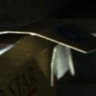

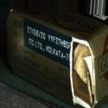




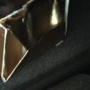
Defects checked via different cameras
S Band Top Camera
IF Camera
Short Mitre
Long Mitre
Label and Price Check
S Band Bottom Camera
Wrapper Camera
Short Mitre
Long Mitre
Open Lid Torn or defective
Wrap
TOR Misaligned

Slide 9
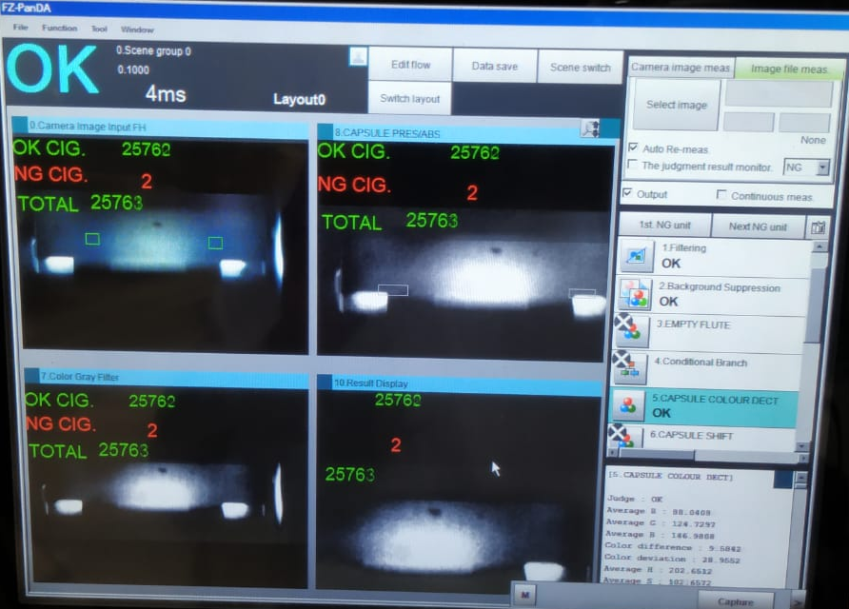
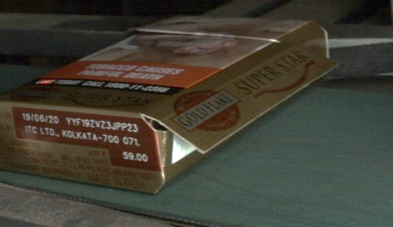
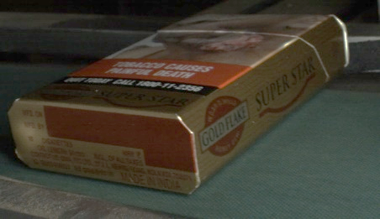
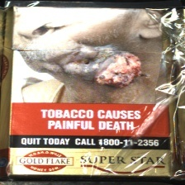
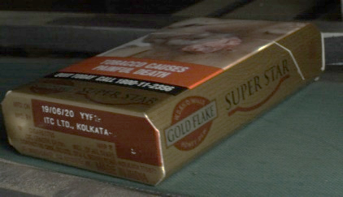
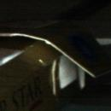
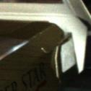
Shift from Conventional to AI system
Conventional System
AI Based machine vision system
Specific Use Case - One defect
Good/bad decided on threshold pixel value
Inability to handle any deviations
Pixel matching faster
Number and types of defects can be large
Use neural networks to learn about defects
Can incorporate deviations in capturing
Slower than conventional systems
eg. Capsule Detection
Need for AI system for this use case
Simple use case of
Presence check
Color check via RGB
- Many types of defects in every image captured
- Many variations in terms of size, position & intensity of every defect
Laser missing & misprint
Long Mitre open
Bad Wrapping
Short Mitre open

Slide 10
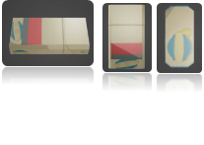
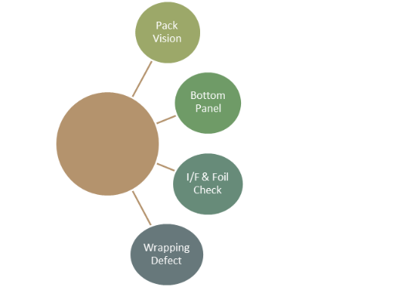
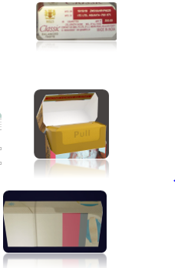
Defects Distribution in Cigarette Packets
Statutory Compliance:
Laser Missing
Pack Price Check
Complaints Category defects:
Damaged Pack (Mechanical damage)
No Lid or Torn Lid
Misaligned or Torn I/F and foil
TOR missing
Minor Irritant Complaints:
Short Mitre and Long Mitre Open
Burnt Wrapper
All 6 pack panels
Integrated Autonomous Quality Check on Packer
Laser Print – Bottom Panel
I/F and Foil
Wrap and TOR

Slide 11
Infrastructure
Lighting
Camera
Communication
Machine Learning Algorithm
Processing Unit
MACHINE VISION SYSTEM

Slide 12
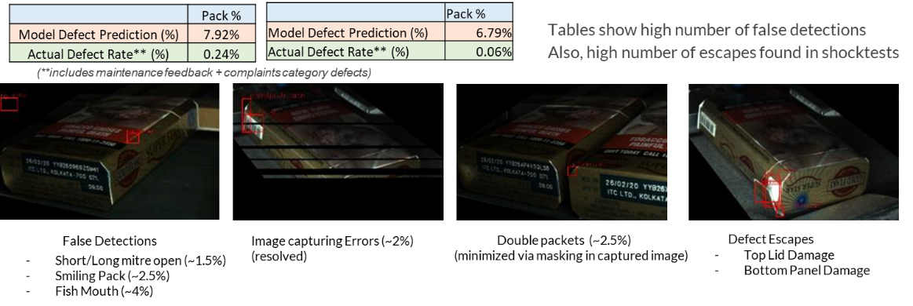
Status at Start of Project
Cam 2 Results
Cam 3 Results
Concerns
ITC gets a pretrained file from vendor, not the model
Development in model requires Vendors support and
Most importantly, at the start, accuracy was low & false detections were high

Slide 13
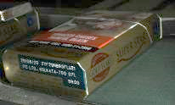

Defects Prioritization
Severity | Occurrence | Detection capability
9 – Stat. compliance & severe consumer complaints | 9 – Occurs once every hour | 9 – detection dependent on operator alertness
6 – Consumer Complaints | 6 – Occurs once every shift | 6 – system present to detect, however may fail
3 – Irritant to consumer & potential market complaint | 3 – Rare defect | 3 – system detection capability is good
1 – minor irritant to consumer | 1 – Robust system: very rare occurrence | 1 – System mature to detect most occurrences
Camera View
Camera 3
Defect | Severity | Occurrence | Current Detection Capability | RPN
Damaged or missing I/F | 6 | 3 | 1 | 18
Damaged or missing Foil | 6 | 3 | 1 | 18
Laser Print Missing or Partial Print | 9 | 1 | 3 | 27
Pack Price Check | 9 | 1 | 3 | 27
Bottom/Front Panel Damaged | 9 | 3 | 9 | 243
Short Mitre Open | 3 | 6 | 9 | 162
Long Mitre Open | 3 | 6 | 9 | 162
Top Lid/Back Panel Damaged | 9 | 2 | 9 | 162
No Lid / Torn Lid | 9 | 1 | 9 | 81
TOR Missing/Misposition | 6 | 3 | 9 | 162
Poor Wrapping | 6 | 6 | 6 | 216
Open Wrap | 6 | 6 | 6 | 216
Camera Selection
Camera 4
 | Sum of RPN
Cam 1 | 36
Cam 2 | 567
Cam 3 | 621
Cam 4 | 594

Slide 14

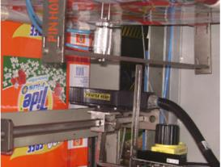
Literature Survey
Learned Image analytics from Stanford Open Source Program on CNN’s for Visual Recognition
Researched papers on defect detection and clustering algorithms
Learned KERAS API and Tensorflow for training model
Learned about Cuda Setup for faster GPU Computation and online deployment of model
Industries employing image detection:
Consumer Products – P & G India – MRP Checking and brand integrity checking
Food and Beverage – Beer Bottle Cap –System checks for overprint errors, design deviation, surface scratches.
IKEA Poland – Checking Lamination on boards
Beer bottling industry
P & G India (Checking MRP)

Slide 15
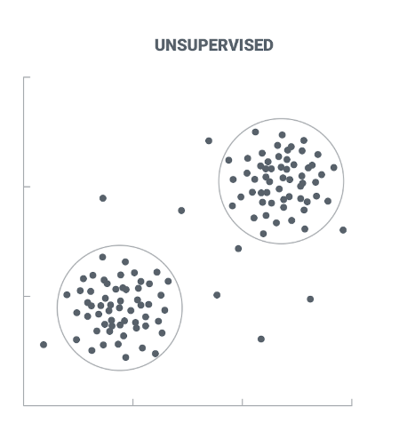
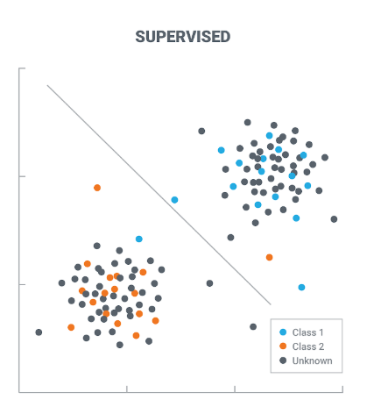
Training Algorithms
Unsupervised Learning Algorithm
Supervised learning algorithm
Training requires only non-defective images
Classify the problem as clustering information
Features are extracted from image, namely contrast, colour histogram etc and clustered together.
Faster and less computation
Easy to train (only one kind of images needed )
Training model requires both defective and non-defective images
Classify the problem as having two classes : defective set and non-defective set
Features are extracted and trained for specifying which feature are particular to defective images and non-defective images
More Computation
Training dataset requires around 400 – 500 defective images per defect

Slide 16
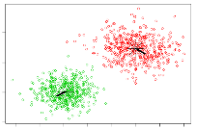
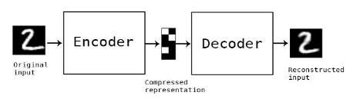
Unsupervised Learning Approach
Basics of Unsupervised Algorithm:
Use only Non-Defective photos for training the network
Work on principle of Clustering features that appear similar
Fast Computation and Easy to Scale
Clustering Algorithms Used : OC-SVM and AutoEncoder
OC-SVM
Features are extracted from image
Boundary is made around features
AutoEncoder
Image compressed to meaningful data
If new image, also compresses to same data predict it as non-defective

Slide 17
Shock Test Results with Unsupervised learning
Long Seam Defect | Defected Predicted | Non-defective Predicted
Real Defective | 26 | 2
Real Non-Defective | 1 | 149
Fishmouth Defect | Defected Predicted | Non-defective Predicted
Real Defective | 31 | 5
Real Non-Defective | 2 | 60
False Detection : 0.66%
Accuracy : 92.86%
False Detection : 3.22%
Accuracy : 86.20%
Issues in unsupervised learning:
Low Accuracy and high false detections ( Not acceptable to industry standards )
Cannot increase accuracy beyond certain order
High dependency on kind of features extracted ( Diff. defects cannot be trained similarly )

Slide 18
Approach for Algorithm Development
Supervised Learning
Unsupervised Learning
Software Interfacing
Supervised Learning
Code Optimization
Developed an unsupervised learning algorithm which can predict defected packets from undefective packets by only training on undefective packets
Worked by extracting important features from image and clustering good images data.
Developing new interface code b/w camera & system to generalize solution for scalability
Minimize vendor dependability
Training use both defective and non-defective images
Increase model accuracy for better defect capturing and less false detections
Also, included label blank defect in training
Final codes are trained and deployed on running line
Speed efficiency was optimized by making batches of images
Final Training codes are developed for easy future replication and scalability

Slide 19
Approach for Algorithm Development
Supervised Learning Model:
Pros
Accuracy can be increased by increasing dataset
Transfer learning approach can be used for training classification network
Less dependency on feature extraction part ( because training extracted features )
Industry employment in Ikea and Beer Industry Vision Systems
Cons
Require both good and bad images – high dataset
Use Supervised Network
Classify as classification problem :
2 classes
Use Transfer learning
Initial layers of network are freezed (Image training)
Optimize the code by checking diff. models of classification

Slide 20
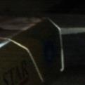

Transfer Learning
learning uses pretrained network
Cannot train a neural network from scratch with less than 1 lakh images
Initial layers are kept same and only last layer is trained for new features
Pretrained Layer
Pretrained Layer
Trainable layer
Prediction Probability
Training requires around 4000 images

Slide 21
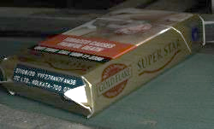
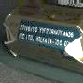
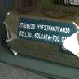
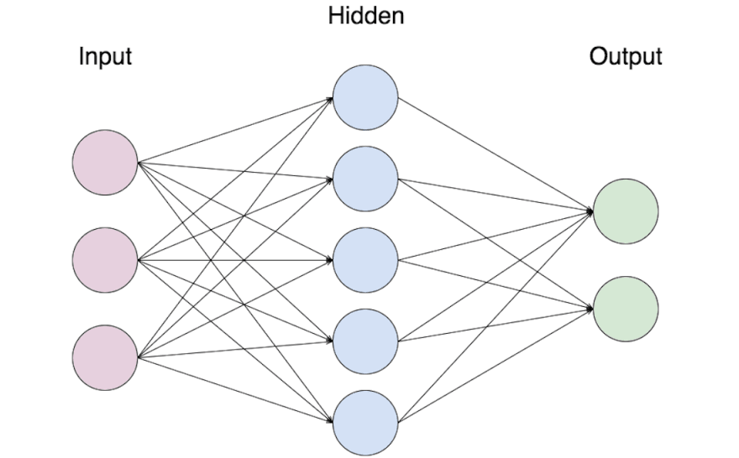
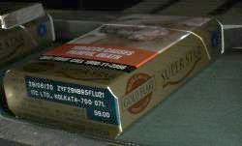
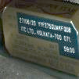
Supervised Learning – Training Process
Pretrained Layer
Pretrained Layer
Trainable layer
Augmented x10 or x5
Defected Label
p
Bad
1-p
Good
Original Images not augmented
Neural network is trained
VGG-16 Model
Prediction Probability for both classes
2000 images of each class are trained
Undefected Label
Image Acquisition
Augmentation
Training
Test & Retrain
Both defective and undefective images
Requires 400-500 images of each defect like short mitre, long mitre and top lid
Model requires around 2000 images for correct prediction, hence each image is annotated by small rotation, brightness or hue change and horizontal shift
Images are fed to model which works on transfer learning approach
Here, a pretrained network is modified at end to train our own images
Online tests to determine overall accuracy of system
Shocktests for initial accuracy of model version
Model is retrained to reduce escapes & false detections

Slide 22
Transfer Learning
Different training approaches used :
Transfer learning with VGG-16 – 537MB in size – Has 16 layers
Transfer learning with ResNet-50 – 98MB in size – Small size means less computation
Tried decreasing 5 layers in VGG-16 as well to decrease size and computation
Metrics to calculate training of model:
Accuracy ( Above 99%)
Loss function ( Ideally less than 0.05 desired )
Validation Set – Accuracy ( Above 98% desired )
VGG-16 : Achieves all parameters after 40 epochs
ResNet : High loss (above 0.1) after 80 epochs
VGG-16 (less layers) : High loss and less accuracy ( around 94% )
Hence, finalized to use only VGG-16 with full layers for training

Slide 23
Transfer Learning
Optical Character Recognition (OCR)
Supervised Learning Model
Conventional Methods
MRP Check
Short Mitre defective/open
Long Mitre defective/open
Top lid defective/torn/open
Bottom Label defective
Laser Missing
Burnt Wrap
TOR absence Check
Machine Learning models are good when trained on 400 – 500 bad images with significant area covered by the defect itself
Tesseract Library by Google can check MRP
Pixel Calculation

Slide 24
Shock Test Results (Goldflake Superstar Blue)
Cam 3
Defects checked : Short Mitre, Long Mitre and Label Area
Defects | Samples Tested | Samples detected | Samples Not Detected
Short Miter | 19 | 18 | 1
Long Miter | 24 | 22 | 2
Label Damage | 38 | 38 | 0

Slide 25
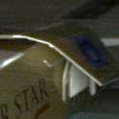
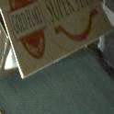
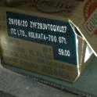

Cam 4
Warp Damage
Training Dataset
Cam 3
Short Mitre
Training Dataset
Validation
Long Mitre
Training Dataset
Validation
Label Damage
Training Dataset
Validation
Validation
6000 images
120 images
120 images
120 images
120 images
5000 images
5000 images
4000 images
Accuracy:100%
Accuracy:100%
Accuracy:100%
Accuracy:98.3%
Training Dataset – For cam 3 & 4

Slide 26
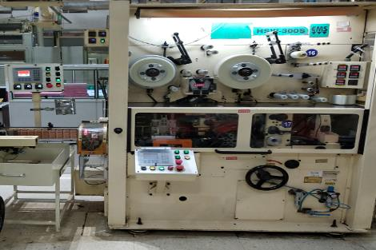
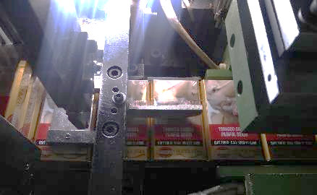
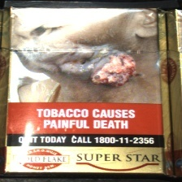
Wrapper Areas
Inside Wrapper
turret
Stack pusher
Guide for jamming detection & also to prevent packet jumping
Top heater
Stack formation
Top heater
Current camera focuses on this packet for scanning wrapping quality (only possible location)
Only available area for wrapping quality detection
Image captured
Packets here are stacked one after another
This makes U tab tough to be recognized even to the human eye
In this setup, it is very difficult to capture U tab in the image, moreover train any model to detect this. Hence we cannot include U tab detection in our system.

Slide 27
Training dataset for Cam 3 and Cam 4
Camera No. | Defects | Training Dataset Defective Augmented Defective Non-Defective |  |  | Validation Dataset Defective Non-Defective |  | Val. Accuracy after 40 epochs
Cam 3 | Short Mitre | 816 | 1435 | 3692 | 60 | 60 | 1.00
 | Long Mitre | 613 | 1085 | 3692 | 60 | 60 | 1.00
 | Label Damage | 378 | 1043 | 3692 | 60 | 60 | 1.00
Cam 4 | Wrap Defect | 122 | 1088 | 2632 | 60 | 60 | 0.983

Slide 28
Line Test Results ( Goldflake Superstar Blue)
Cam 3 : Total packets checked 58291
Defects | Defective Predicted | Correct Defective | False Detection | Other Defect Captured or Camera error | Non Defective Predicted | Escapes
Short Mitre | 141 | 83 | 32 | 26 | 58189 | 24( training these images will eliminate this)
Long Mitre | 134 | 99 | 31 | 4 | 58179 | ~0
Label Damage | 80 | 34 | 41 | 5 | 58230 | ~0

Slide 29
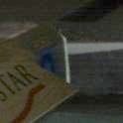
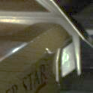
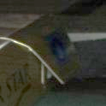
Cam 3 – Short Mitre Defects Results
Out of 80,000 packets checked
Short Mitre Defect | Defected Predicted | Non-defective Predicted
Real Defective | 83 | 2
Real Non-Defective | 58 | ~80000
Long seam get captured as short mitre defect
Increasing dataset will solve the problem
False Detection : 0.04%
Accuracy : 97.64%
Examples of some detected defects

Slide 30
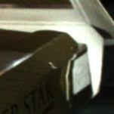
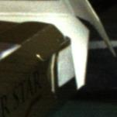
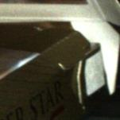
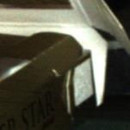
High Escape rate in short mitre
Found 24 defected short mitre being detected as non-defective
Reason:
This defect needs to be treated differently than short mitre open
Classified as short mitre + open lid
Training was done without using such images
Increasing the training dataset will solve this problem
Examples of escaped short mitre defects

Slide 31
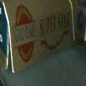


Cam 3 – Long Mitre Defects Results
Out of 80,000 packets checked
Long Seam Defect | Defected Predicted | Non-defective Predicted
Real Defective | 99 | 0
Real Non-Defective | 35 | ~80000
False Detection : 0.038%
Accuracy : 100%
Examples of some detected defects

Slide 32



Cam 3 – Bottom Panel Defects Results
Out of 80,000 packets checked
Label Damage Defect | Defected Predicted | Non-defective Predicted
Real Defective | 34 | 0
Real Non-Defective | 46 | ~80000
Label area are generally good
Most of time long seam defect get detected in these images
(Training dataset expanded to take care of this issue)
False Detection : 0.05%
Accuracy : 100%
Bottom Panel Damaged
Shock Test of Label Print Missing predicted 79 detected images out of which 77 were correct prediction

Slide 33


Cam 4 – Wrap Damage Defects Results
Image captured has very low difference between non-defected or defected wrap
Most severe cases where product has sufficient differentiation in image is trained
Captured 13 defective images in 1,00,000 packets checked
Defective images captured

Slide 34




New Learnings from Test Runs
Open Lid (both short mitre open) Spotted in test run
Bottom Damage at Corner
New type of damage identified
1 Reverse Packet in Wrapper
Defective Long seam blocks the view of short mitre and sometimes detected as short mitre defective
More training set needed

Slide 35








Cam 4 Results Examples
Good Captured
Bad Captured

Slide 36




Tasks employing Machine Vision
Guidance:
Locate position and orientation of a part, compare it to a specified tolerance, and ensure proper assembly
Identification:
Part identification and recognition reads data matrix codes
Guaging:
Calculates the distances between two or more points specifying tolerance levels
Inspection:
inspection detects defects, contaminants, functional flaws, and other irregularities in manufactured products

Slide 37

Future development
MRP Check : OCR Check is responding 48% of the time Accuracy of OCR affected by skewed angle of camera feed Custom Train Simpler OCR
TOR Presence and Position Check: Diffused Lighting Needed Similar case as PCT Vision System Use conventional techniques (hue check)
New types of lighting arrangement to be tested

Slide 38
Workstation Costing Details
Workstation Configuration for Pack vision system
SL No. | Component | Description/Part no. | UOM | Unit price | Total price
1 | CPU | Intel Core I7-9700K, SocketLGA1151, 8 core 8 threads | 1 | 38775 | 38775
2 | Mother Board | Asus Prime Z390M plus | 1 | 14990 | 14990
3 | RAM | 16x2 - 32GB DD4 3200Mhz, Corsair vengence | 1 | 14580 | 14580
4 | SSD | 250 GB EVO M.2 Samsung | 1 | 4850 | 4850
5 | HDD | 1 TB WD blue | 1 | 3390 | 3390
6 | GPU | RTX 2080 Ti OC 11GB | 1 | 128000 | 128000
7 | Power Supply | CORSAIR CX 750 , 80 Plus bronze certified | 1 | 7790 | 7790
8 | Network Card | Dlink DGS1008G | 1 | 7980 | 7980
9 | System | Monitor, Keyboard, Mouse | 1 | 15000 | 15000
10 | Cabinet | Cooler Master MasterBox CM694 | 1 | 11848 | 11848
11 | Camera | Vision System VCXG IMX249 | 4 | 52000 | 208000
12 | Lens | Tamron 12mm 1/1.2" F/2.0 | 4 | 21000 | 84000
13 | Shielded cable | 22631 shielded cable 5.0M for camera power | 4 | 2800 | 11200
14 | Ethernet cable | Gigabit ethernet interface CAT7 - 6M | 4 | 2400 | 9600
15 | LED lighting | Light 24V dc LED | 6 | 13800 | 82800
16 | PLC | Micrologics 1400 | 1 | 35000 | 35000
17 | Trigger Sensors | GTB6 | 2 | 6237 | 12474
 |  |  | TOTAL |  | 690277
 | Work Station
 | Camera and accessories
Database maintenance server & dashboarding cost : ~2 lakhs

Slide 39
Vision-System Defect Detection
Conventional Method
Pixel Detection
(Presence Detection)
Counting Features
Machine Learning Method
Unsupervised Algorithm
(Classify untrained objects)
Supervised Algorithm
(Classify trained objects)
Image Classification
Classify image between defective and non-defective
Object Detection
Detect known foreign substance in an image
Clustering Algorithms
Make clusters of similar features
1) OC-SVM 2) AutoEncoder
1) VGG-16 2) ResNet-50 3) MobileNet
1) RCNN 2) FRCNN
Decision Map
Fast
Less computation power
Specific use case
More Computation
Variable use case
High Cost of development

Slide 40
Summary of Results achieved
Camera | Defect | Accuracy in defect detection (in %) | False Detection (in %) | Net False Detection
Cam 3 | Short Mitre | 97.64 | 0.04 | 0.13
 | Long Mitre | 100 | 0.04
 | Label Damage | 100 | 0.05
 | Label Missing | 100 | ~0 (Camera Error only)
Cam 4 | Wrap Defect | 81* | 0 | 0
Cam 2 and Cam 3 are similar
TARGET
Defect Capturing Accuracy
> 98% False Detection (total)
< 0.1%
* Multiple variations in open wrap found, hence continual retraining required

Slide 41


Way Forward
Model trained for 2 brands – to extend concept to multiple brands
Decrease false rejections Cam 3 - Use falsely identified images in retraining
Upgradation of GPU – to reduce skipping rate ( Currently 5GB GPU gives 30% packet skip)
Upgrade Giga Cable – to reduce Image Capturing Error
Limitation in TOR checking due to lack of contrast - to be worked upon
Custom OCR training to make code more speed efficient
Capturing Error
TOR Misplace(less visible)

Slide 42
Thank You

